Slide 1
Osiris Morales
MULT 150

Slide 2

“PETS” RUNNER

Slide 3
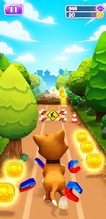

TOP VIEW
POV = Top view
Environment: Trials and Trees
Obstructions: Red Balls
GUI: will show the timer
GAME OVER: when collision
occurs

Slide 4
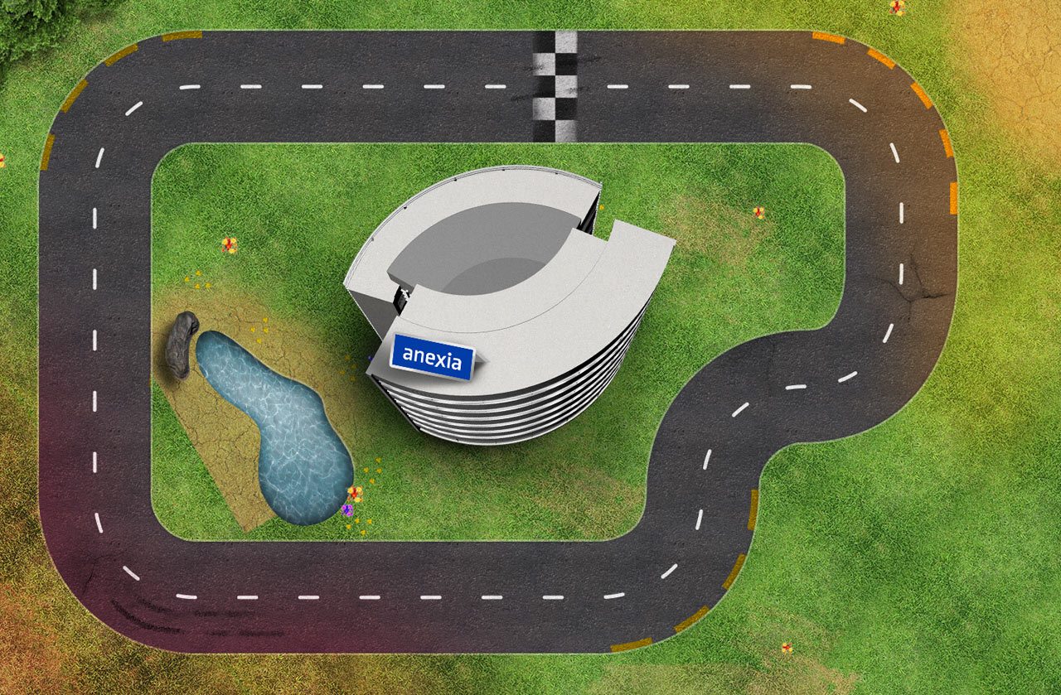
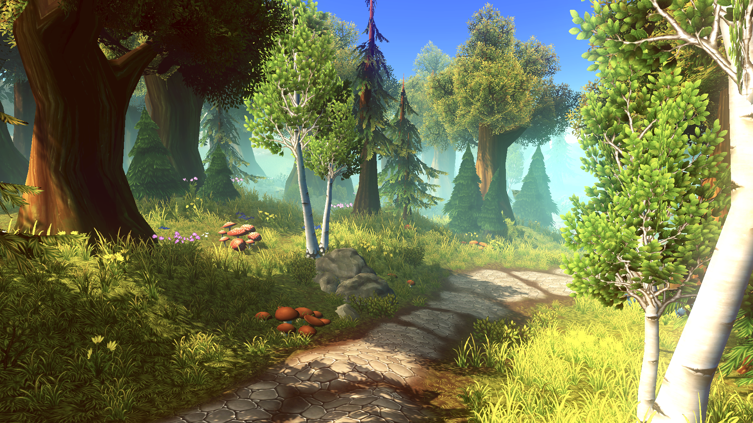
RACE TRACK/ ENVIRONMENT

Slide 5
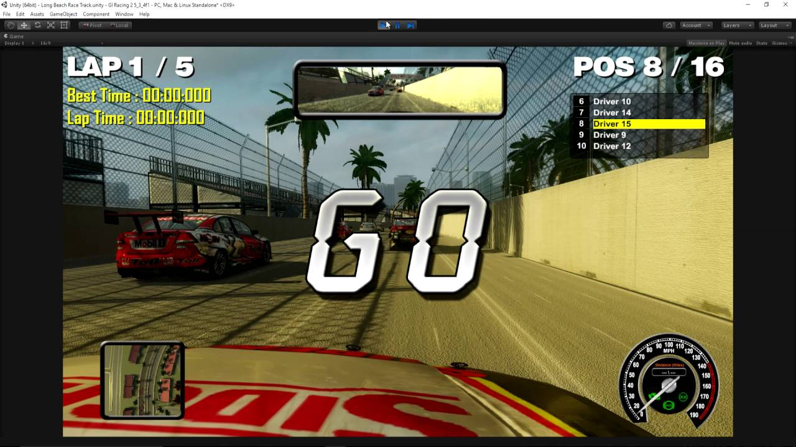

GUIs on Screen

Slide 6
HOW TO PLAY
MOVE LEFT and Right to DODGE any obstructions
How long can you last?
If you hit an Object, then the game starts over

Slide 7
RACE RULES/ CONCEPT
When the race starts, it starts off easy, then gets harder and harder the longer you stay in the race
If you hit something, then it is GAME OVER
There will be a UI that shows how long you’ve been in the race.
Game will restart, Time will restart

Slide 8


